Slide 1
Container Technologies
Ayan Sengupta

Slide 2
What is a container
A container is a standard unit of software that packages up code and all its dependencies so the application runs quickly and reliably from one computing environment to another.
A Docker container image is a lightweight, standalone, executable package of software that includes everything needed to run an application: code, runtime, system tools, system libraries and settings.
Container images become containers at runtime and in the case of Docker containers – images become containers when they run on Docker Engine. Available for both Linux and Windows-based applications, containerized software will always run the same, regardless of the infrastructure. Containers isolate software from its environment and ensure that it works uniformly despite differences for instance between development and staging.

Slide 3
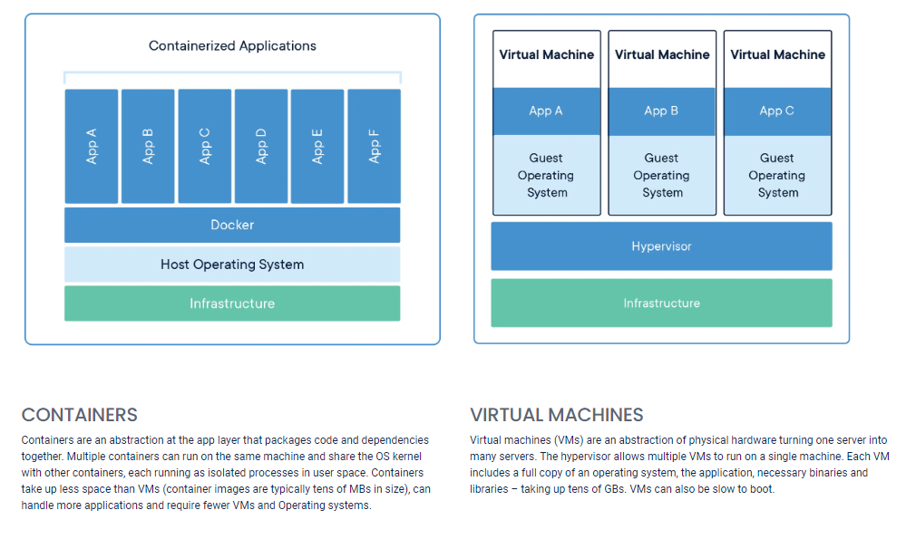
Containers vs Virtual Machine

Slide 4
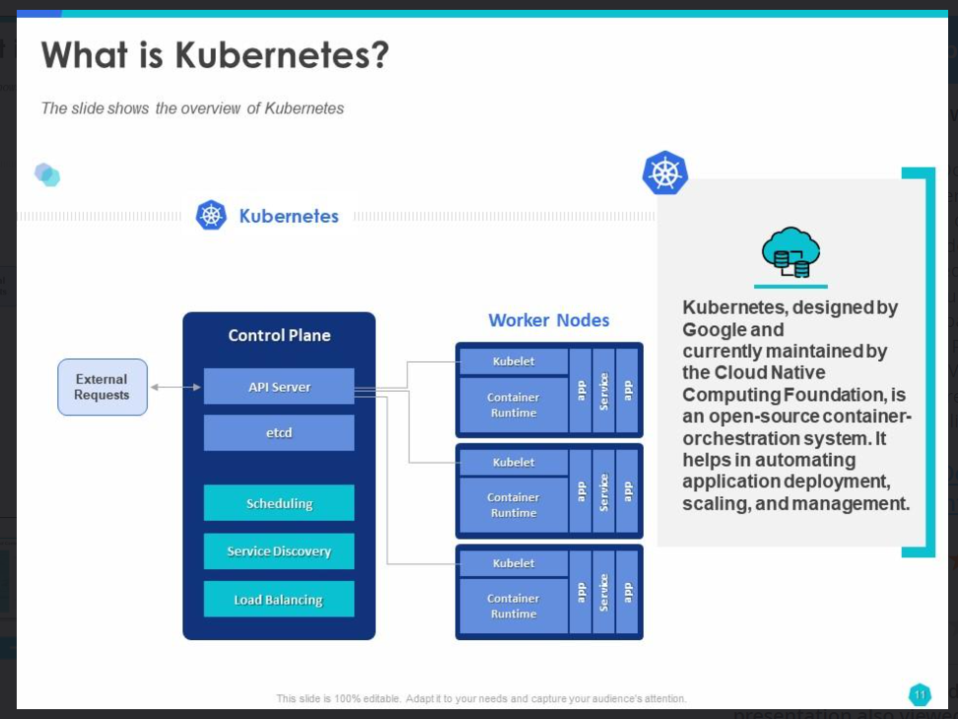

Slide 5
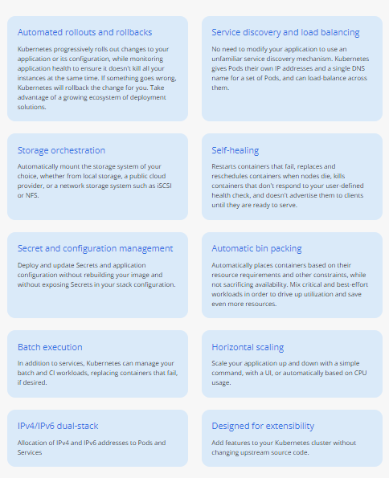
Kubernetes Features
Kubernetes has the following advantages:
Container Orchestration
Automated Load Balancing
Auto Scaling
Rolling Update & Rollbacks
Service Discovery and Load Balancing
Storage Orchestration
Self-Healing
Secrets and Configuration Management
Multi-Cloud and Hybrid Cloud Support
Role-Based Access Control (RBAC)
Pods and Multi-Container Support
Monitoring and Logging

Slide 6
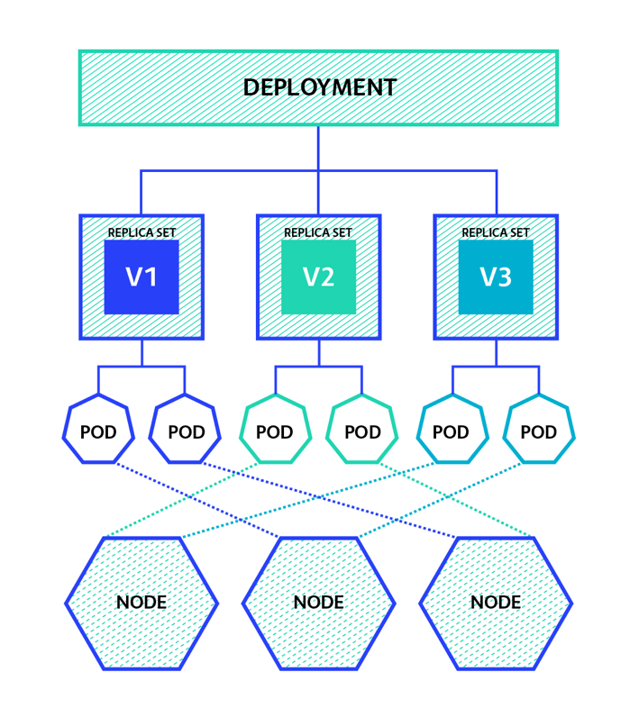
Kubernetes Architecture
Node is a worker machine in Kubernetes and may be either a virtual or a physical machine, depending on the cluster. Each Node is managed by the control plane. A Node can have multiple pods
Pod is a collection of containers and its storage inside a node of a Kubernetes cluster. It allows to abstract the container technology if required. Docker is the most common container runtime used in a Kubernetes Pod.
ReplicaSet maintains a stable set of replicated pods running within a cluster at any given time. Features:
a pod template for creating new pods whenever existing ones fail
replica count for maintaining the desired number of replicas
Deployment tells Kubernetes how to create or modify instances of the pods that hold a containerized application. Deployments can help to efficiently scale the number of replica pods, enable the rollout of updated code in a controlled manner, or roll back to an earlier deployment version if necessary.
Kubernetes Cluster

Slide 7
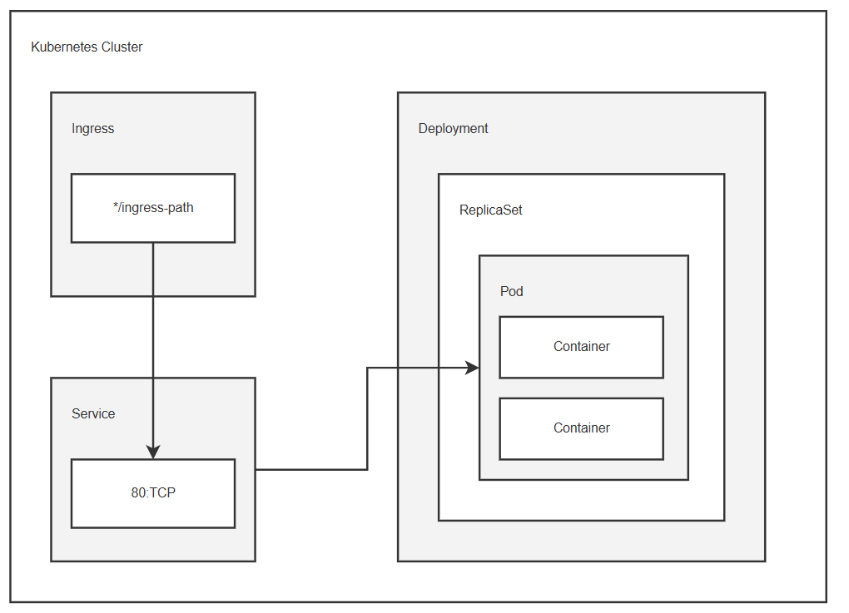
Pod is the smallest deployable unit in Kubernetes, containing one or more containers.
Services provide stable IP addresses and DNS names for a group of pods. They act as a load balancer, distributing traffic across multiple pods. Services can be configured to expose ports to the external world or within the cluster.
Ingress manages external access to services within the cluster, typically via HTTP. It acts as an entry point for traffic, routing it to the appropriate service based on rules. Ingress allows for features like SSL termination, name-based routing, and request rewriting.
ConfigMaps: store non-sensitive configuration data, such as environment variables or configuration files.
Secrets: store sensitive information, like passwords, API keys, or TLS certificates.
Deployments are used to manage the lifecycle of pods, including creation, deletion, scaling, and rolling updates. They ensure that a desired number of pods are running at all times, automatically scaling up or down as needed. Deployments are ideal for stateless applications where each instance is interchangeable like an app.
StatefulSets are used for managing stateful applications that require unique identities and persistent storage. They guarantee a stable network identity and data storage for each pod. Examples of stateful applications include databases, message queues, and file servers.

Slide 8
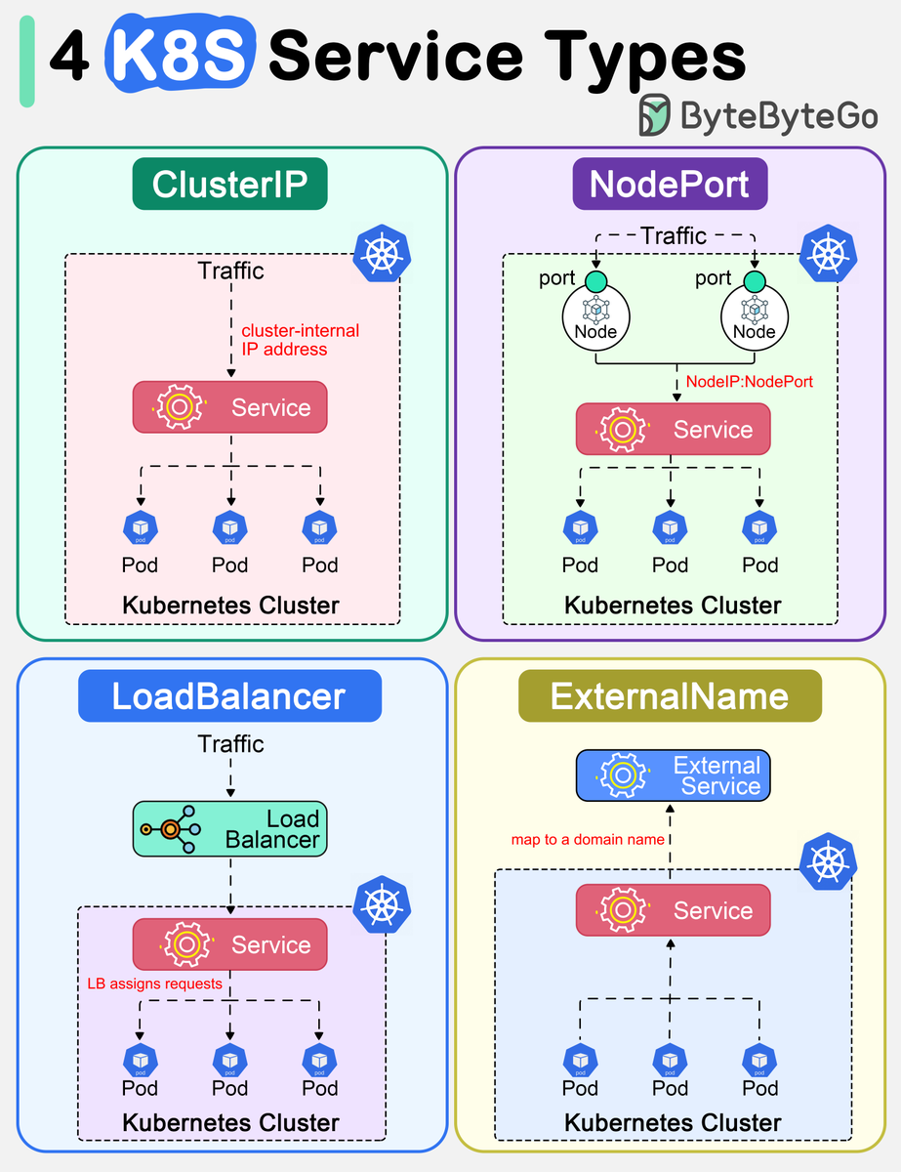
🔹 ClusterIP is the default. Kubernetes will assign a cluster-internal IP address to ClusterIP service. This makes the service only reachable within the cluster.
targetPort : port of the Pod(s)
port : port where the service is available
🔹 NodePort
This exposes the service outside of the cluster by adding a cluster-wide port on top of ClusterIP. We can request the service by NodeIP:NodePort.
targetPort : port of the Pod(s)
port : port where the service is available
nodePort: port of the node machine where the service can be accessed.
🔹 LoadBalancer
This exposes the Service externally using a cloud provider’s load balancer.
targetPort : port of the Pod(s)
port : port where the load balanced service is available
🔹 ExternalName
This maps a Service to a domain name. This is commonly used to create a service within Kubernetes to represent an external database.
externalName: external domain name

Slide 9
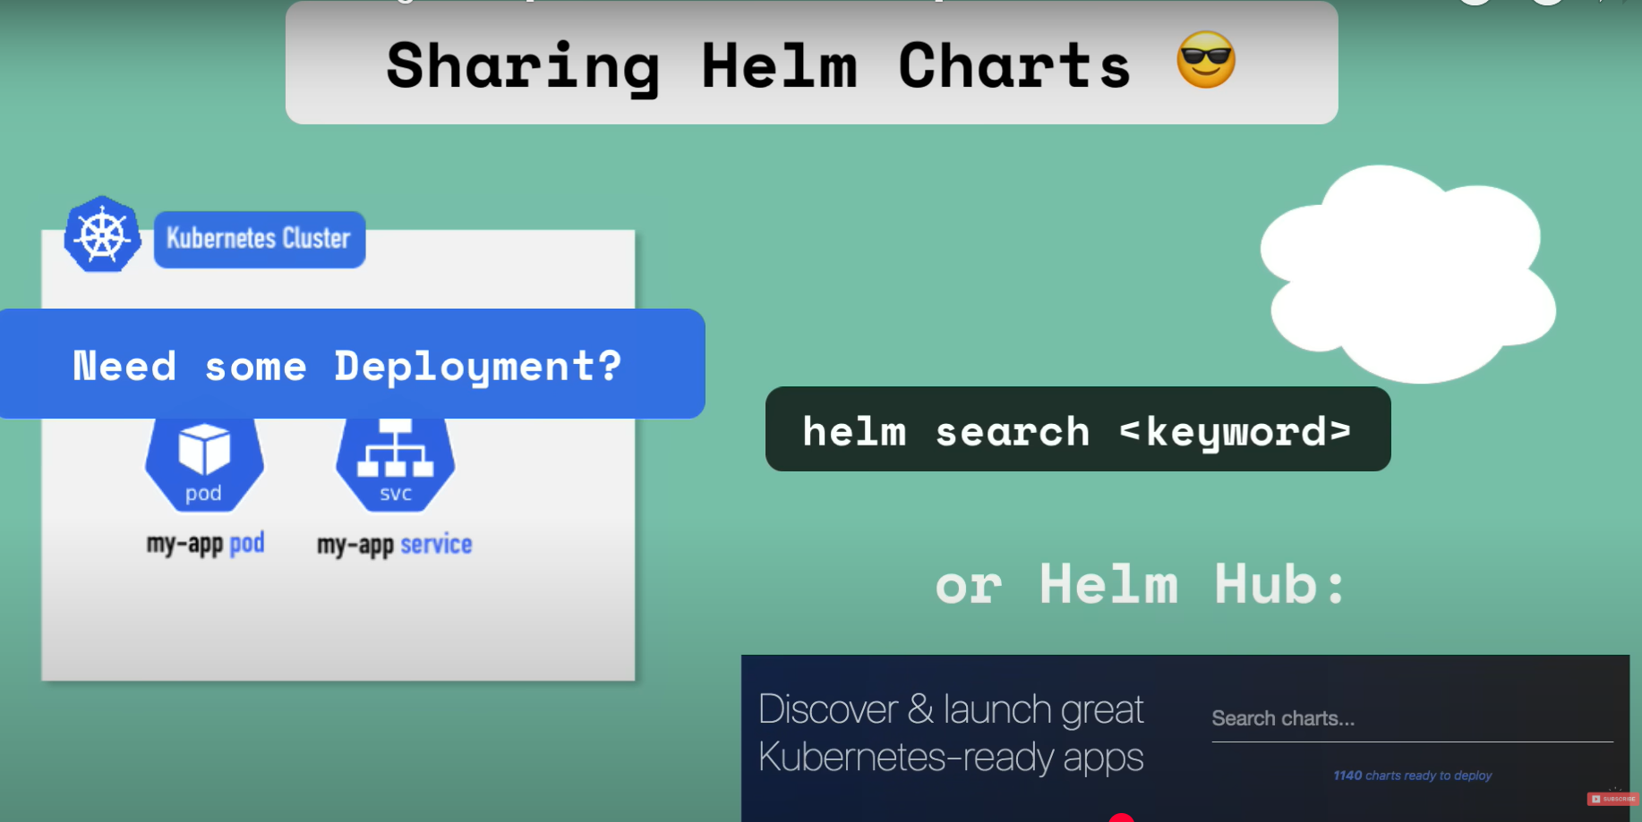
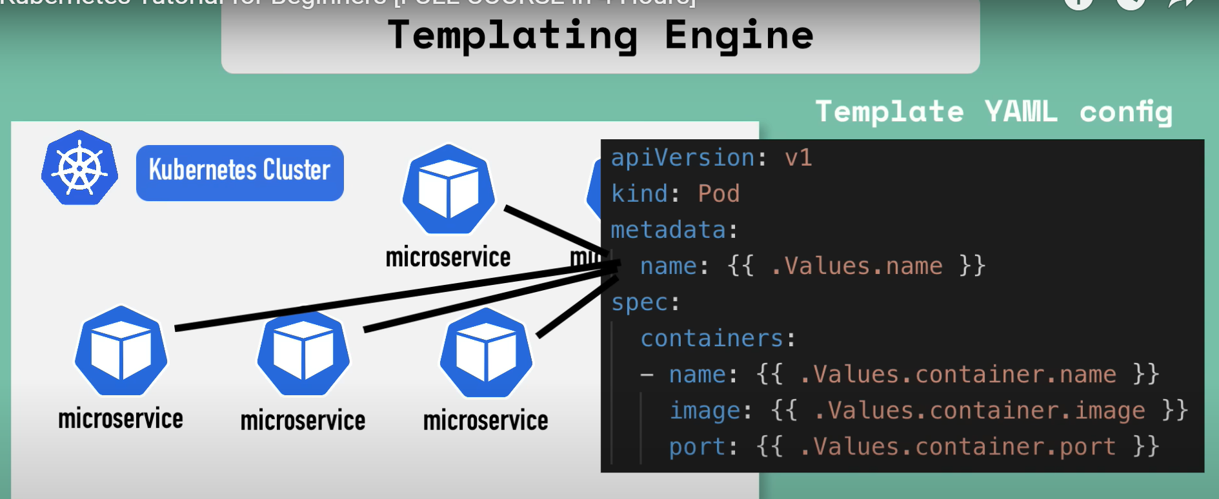
Helm Charts
Template can be used to create different configurations by varying the input values
The package manager for Kubernetes – you can find common helm charts from publicly availed registries

Slide 10
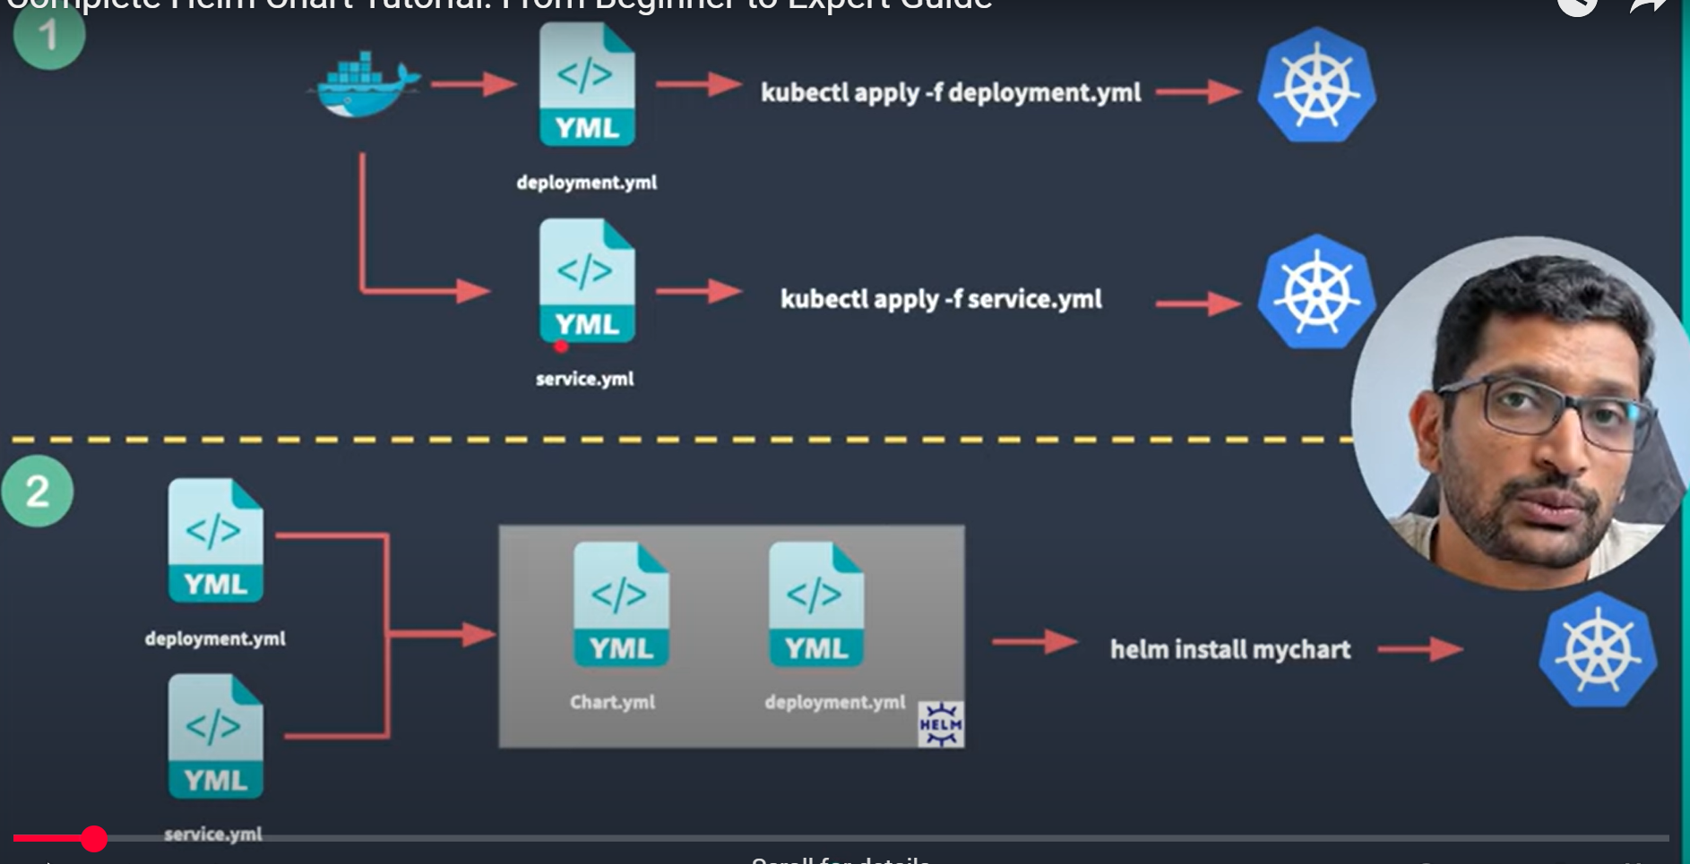
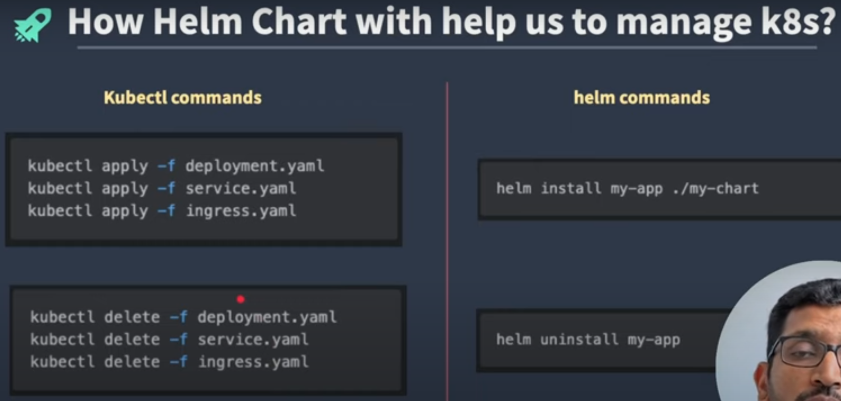
Helm vs k8s
https://www.youtube.com/watch?v=DQk8HOVlumI

Slide 11
In software architecture, a service mesh is a dedicated infrastructure layer for facilitating service-to-service communications between services or microservices using a proxy.
Why use Service Mesh?
Manages Inter-Service Communication: In complex microservices architectures, services need to communicate with each other to fulfill a request. A service mesh acts as an intermediary, managing this communication, according to Amazon.com. Instead of services communicating directly, they send requests through the service mesh's proxies.
Decouples Business Logic from Network Concerns: Before service meshes, developers would often embed logic for tasks like load balancing, retries, and security into the code of each individual service. This led to duplicated effort and increased complexity within the application code. A service mesh abstracts these network-related functions into a separate infrastructure layer, allowing developers to focus on the core business logic of their services.
Enhances Manageability, Observability, and Security: A service mesh provides features that make it easier to manage, monitor, and secure microservices-based applications.
Benefits
Improved Observability: Service meshes offer built-in observability features like distributed tracing, metrics collection, and logging, giving insights into service behavior and performance. This helps identify bottlenecks and troubleshoot issues in complex microservices environments.
Enhanced Security: Service meshes provide security features such as mutual TLS (mTLS) encryption, ensuring secure communication between services. They can also enforce fine-grained access control policies.
Centralized Traffic Management: Service meshes enable fine-grained control over traffic flow between services, supporting features like load balancing, traffic splitting (for A/B testing or canary deployments), retries, and circuit breaking. This enhances reliability and resilience.
Increased Resilience and Reliability: By implementing features like circuit breaking, retries, and timeouts, service meshes help mitigate the impact of failures and network issues, improving the overall fault tolerance of the system.
Faster Development and Deployment: By abstracting network-related complexities, developers can focus on writing and deploying their core business logic more quickly.

Slide 12
Challenges
Increased Complexity: Implementing and managing a service mesh introduces additional components and overhead to the infrastructure.
Resource Consumption: Sidecar proxies consume additional CPU and memory, which can impact performance, particularly in large-scale deployments.
Learning Curve: Teams need to acquire expertise in service mesh technologies to effectively configure and troubleshoot them.
Potential Vendor Lock-in: Some service mesh solutions are tightly integrated with specific platforms, which could limit flexibility and portability.
Popular Service Mesh Implementations
Istio: A widely adopted, feature-rich service mesh, often used with Kubernetes.
Linkerd: A lightweight and easy-to-use service mesh focused on simplicity and performance.
Consul Connect: Offered by HashiCorp, it provides service mesh features as part of its service discovery and configuration platform.
AWS App Mesh: Amazon's fully managed service mesh, tightly integrated with AWS services.
https://www.youtube.com/watch?v=16fgzklcF7Y
https://www.youtube.com/watch?v=voAyroDb6xk

Slide 13
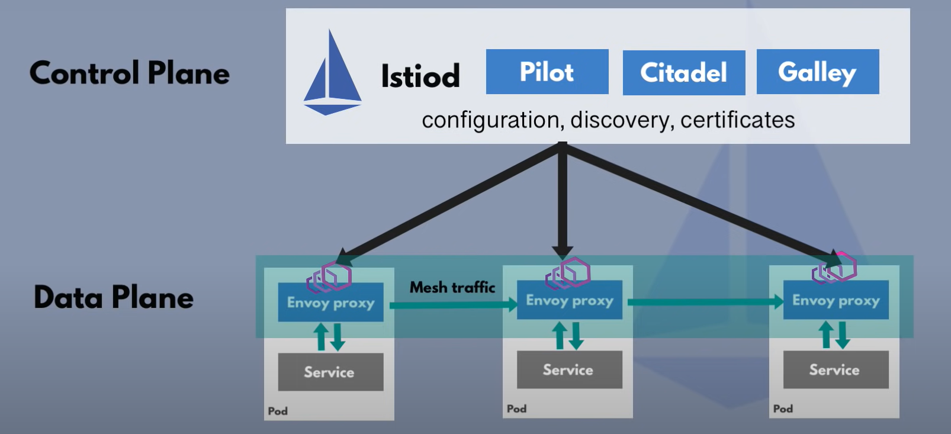
Istio Architecture
Data Plane: This consists of lightweight proxies, often referred to as sidecars, deployed alongside each service instance. These sidecars intercept and manage all incoming and outgoing traffic for the service. They handle tasks such as traffic routing, load balancing, enforcing security policies, and collecting telemetry data.
Control Plane: This acts as the central management layer, configuring and monitoring the data plane. It allows administrators to define and distribute policies, security settings, and traffic rules to the sidecar proxies. The control plane also collects and aggregates telemetry data (metrics, logs, traces) from the sidecars, providing insights into the microservices' communication.

Slide 14
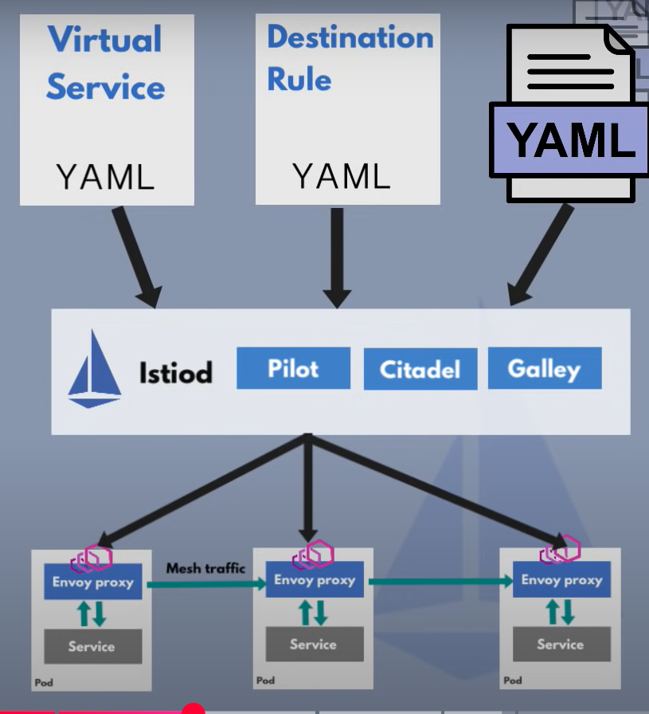
Virtual Service and Destination Rule
VirtualService:
Defines a set of traffic routing rules for a given host or set of hosts.
Specifies how traffic should be directed based on criteria like HTTP paths, headers, or other conditions.
Uses routes to forward traffic to specific destinations, which can include hostnames, subsets (defined in DestinationRules), and ports.
Can be used for tasks like A/B testing, canary deployments, and traffic shifting.
DestinationRule:
Defines policies that are applied to traffic destined for a service after routing is complete (i.e., after the VirtualService has been applied).
Can specify how traffic should be load-balanced (e.g., round robin, least connections).
Can define subsets of a service, which are groups of instances with specific labels (e.g., version numbers).
Can configure connection pool settings, fault injection (e.g., delays, aborts), and retries.

Slide 15
Installation
install istioctl in local
Istio can be installed into an k8s cluster using istioctl or helm
For automatic sidecard injection we need to label the namespace istio-injection=enabled
Deploy the application into this namespace and it should get an automatic sidecar injection

Slide 16
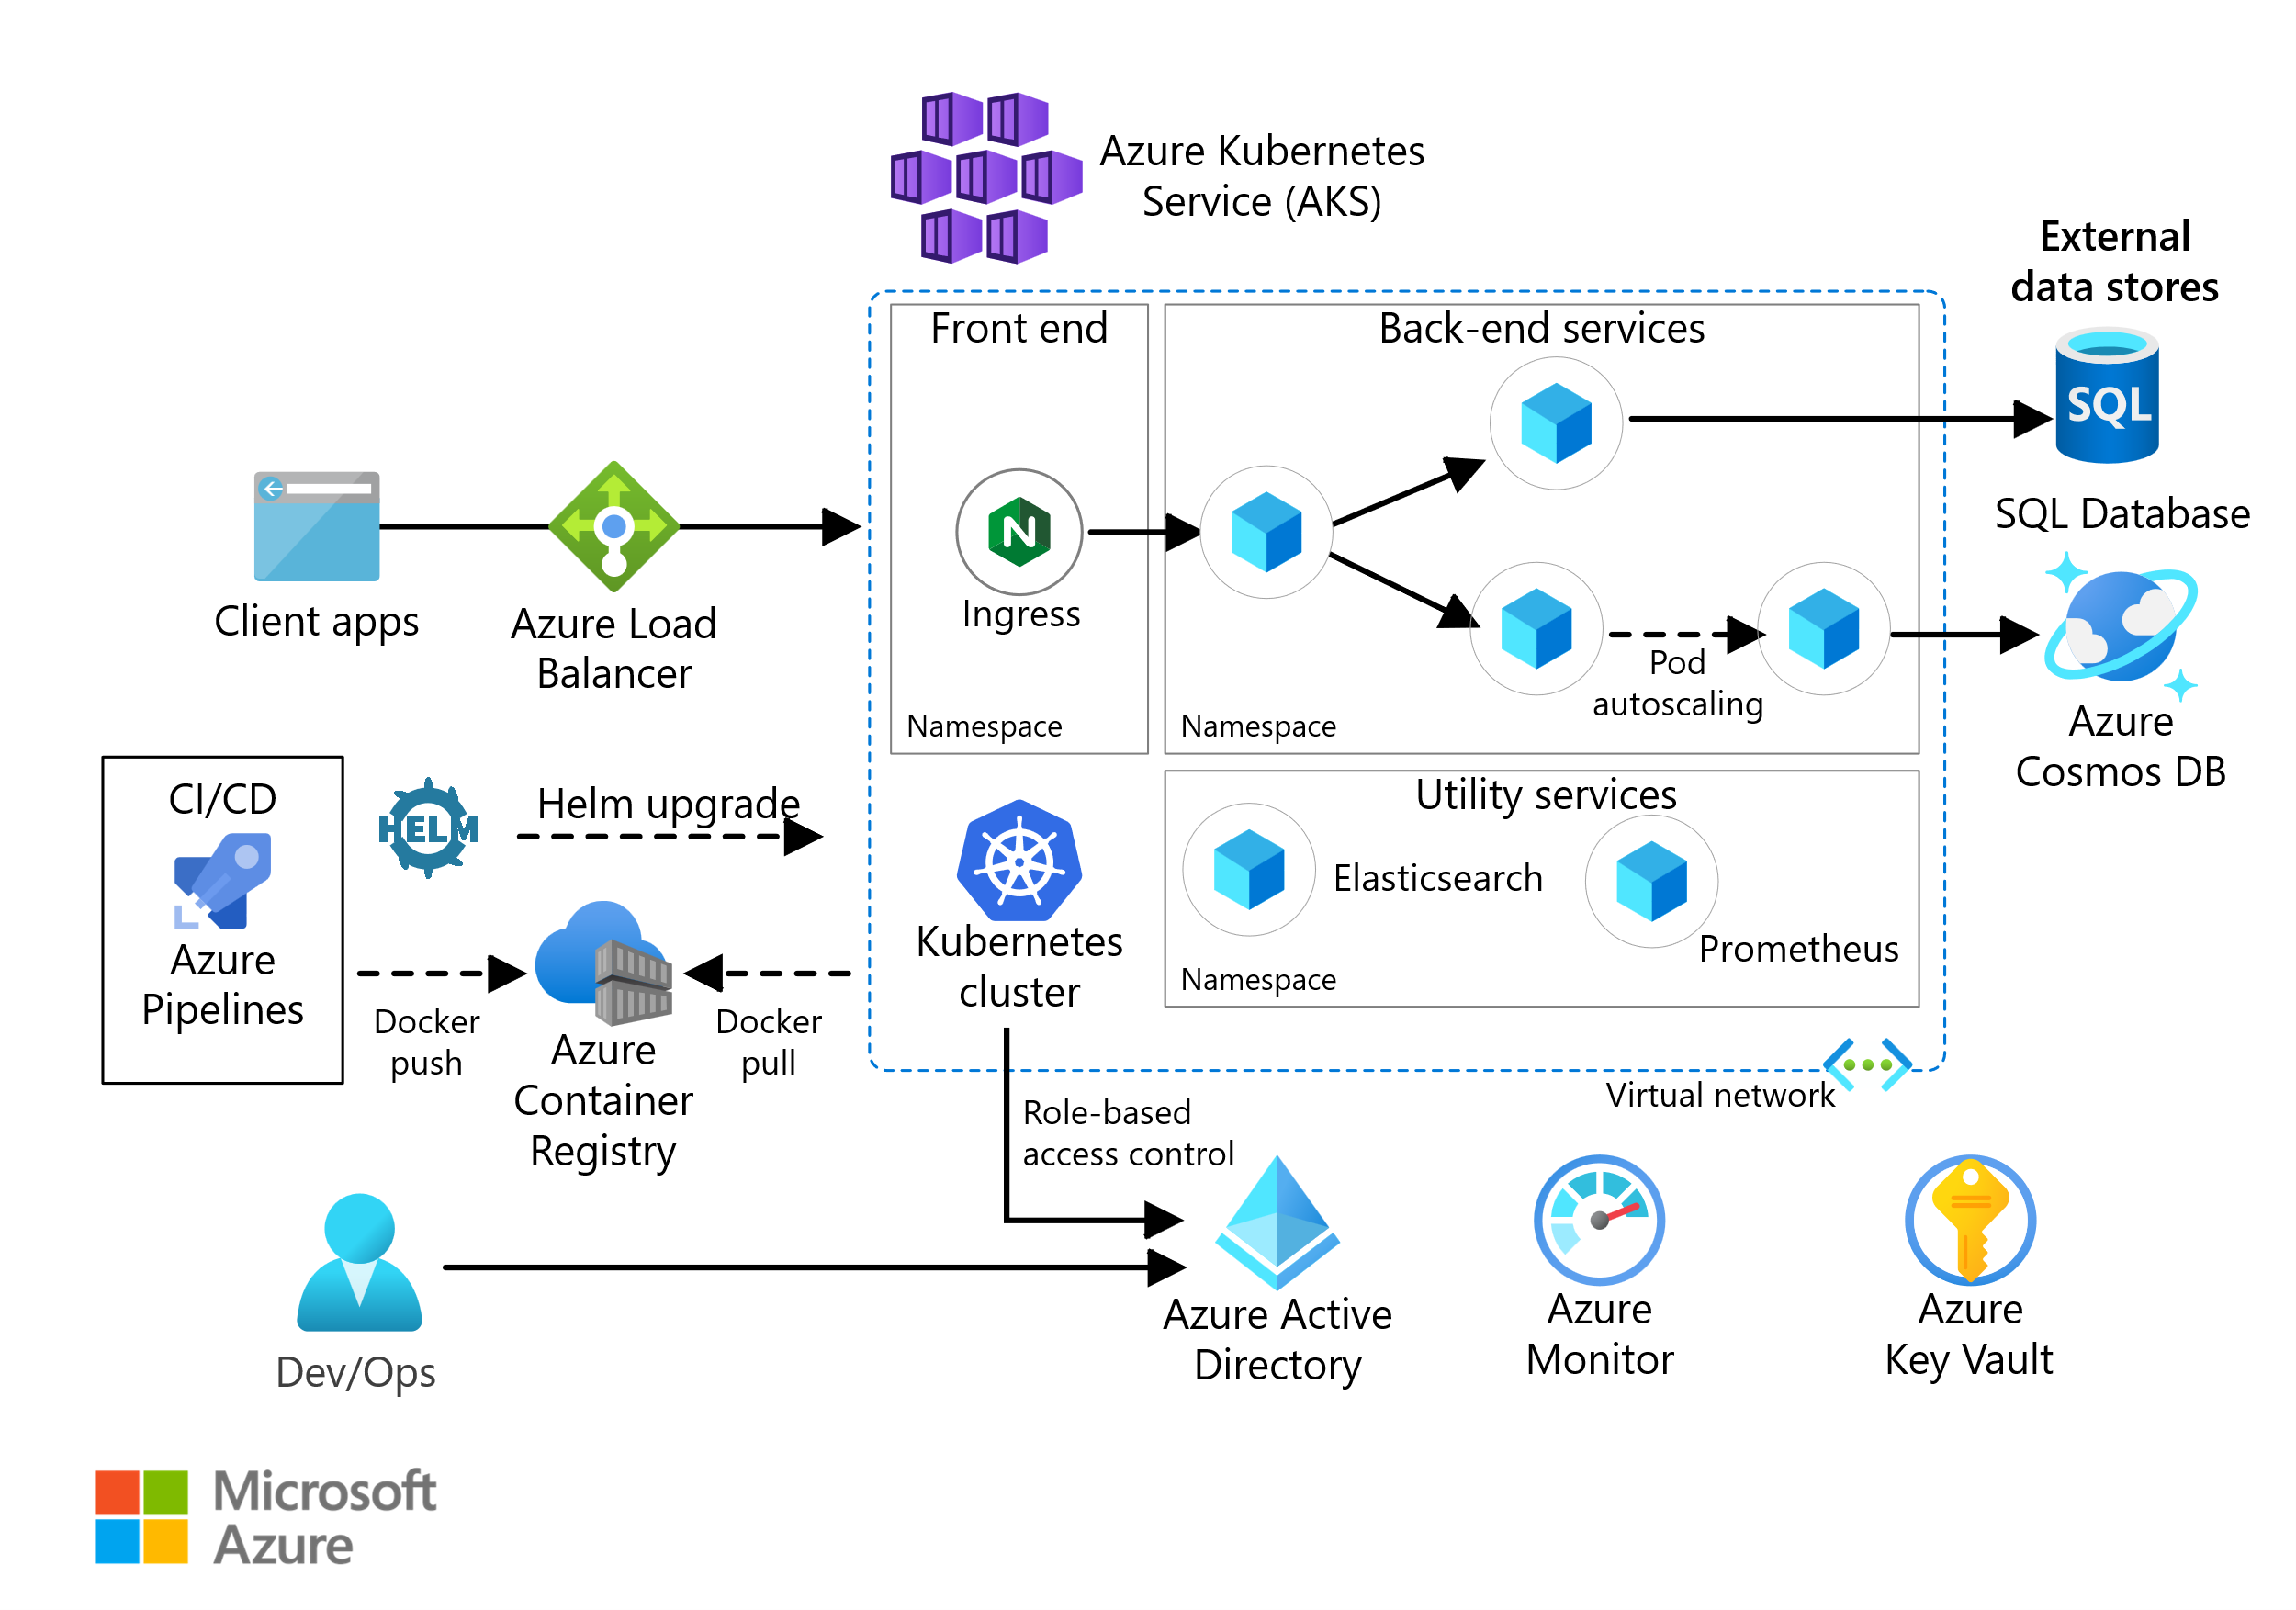
Azure Kubernetes Service - Managed Kubernetes service on Azure

Slide 17
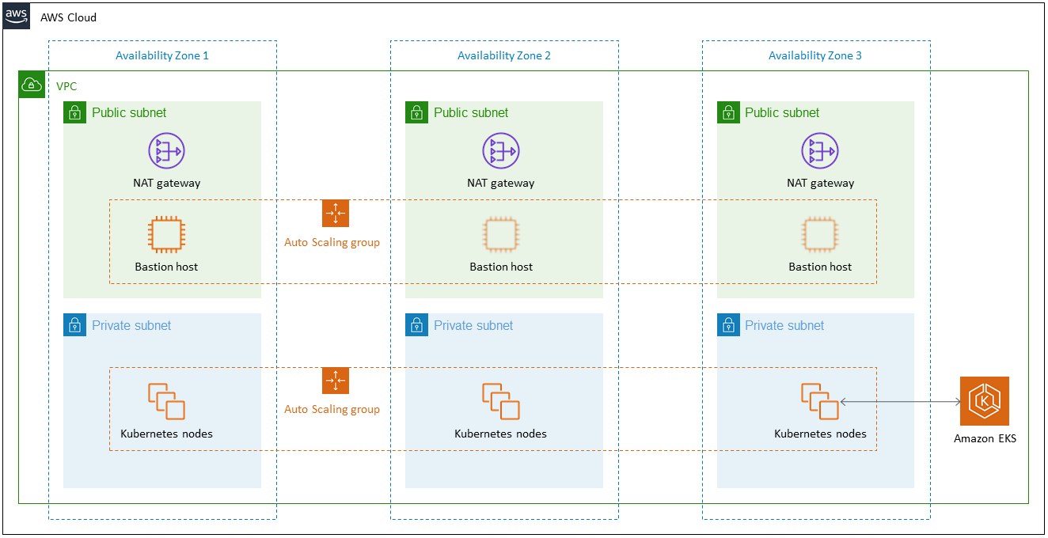
Elastic Kubernetes Service – Managed option on AWS

Slide 18
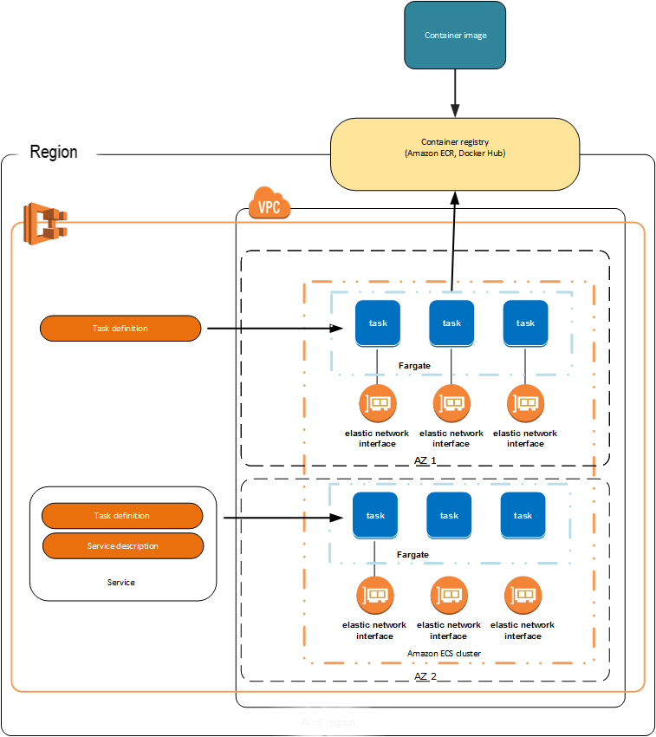
Elastic Container Service – AWS Native and Opiniated offering
AWS Fargate is a serverless, pay-as-you-go compute engine that allows you to focus on building applications without managing servers.
We can choose between EC2 vs Fargate compute options for both ECS and EKS

Slide 19
References
https://katharharshal1.medium.com/kubernetes-objects-pods-replicasets-and-deployments-44f16b38d9f7
https://www.devopsschool.com/blog/amazon-elastic-kubernetes-service-amazon-eks-architecture-explained-with-diagram/
https://bluexp.netapp.com/blog/aws-cvo-blg-aws-ecs-in-depth-architecture-and-deployment-options

